Slide 1
Recitation 10: Malloc Lab
Instructors
October 21, 2019
Notes:
This recitation has fewer questions. Get to the GDB part 1 without spending too long quizzing people on the previous slides.

Slide 2
Administrivia
Malloc checkpoint due Tuesday, October 29! yeeT
Malloc final due the week, Tuesday, November 5! yooT
Malloc Bootcamp:
Sunday, October 27 at Rashid Auditorium, 7-9PM 🤠
We will cover ✨fun and flirty✨ ways to succeed post-malloc checkpoint!
Tell your friends to come (if they’re in 213 (if they want to come (don’t force your friends to do things they don’t want to do that’s not what friends are for)))

Slide 3
Checkpoint Submission
Style Grading
We will grade your checkheap with your checkpoint submission!
Things to Remember:
Document checkheap
See writeup for what to include in checkheap

Slide 4
Outline
Concept
How to choose blocks
Metadata
Debugging / GDB Exercises

Slide 5
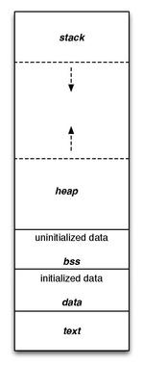
What is malloc?
A function to allocate memory during runtime (dynamic memory allocation).
More useful when the size or number of allocations is unknown until runtime (e.g. data structures)
The heap is a segment of memory addresses reserved almost exclusively for malloc to use.
Your code directly manipulates the bytes of memory in this section.

Slide 6
Concept
Overall, malloc does three things:
Organizes all blocks and stores information about them in a structured way.
Uses the structure made to choose an appropriate location to allocate new memory.
Updates the structure when the user frees a block of memory.
This process occurs even for a complicated algorithm like segregated lists.

Slide 7
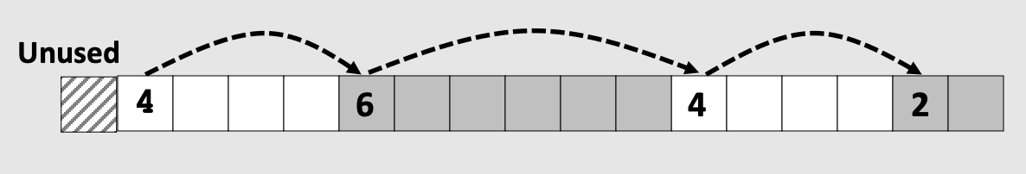
Concept (Implicit list)
Connects and organizes all blocks and stores information about them in a structured way, typically implemented as a singly linked list
Notes:
add image from lecture

Slide 8
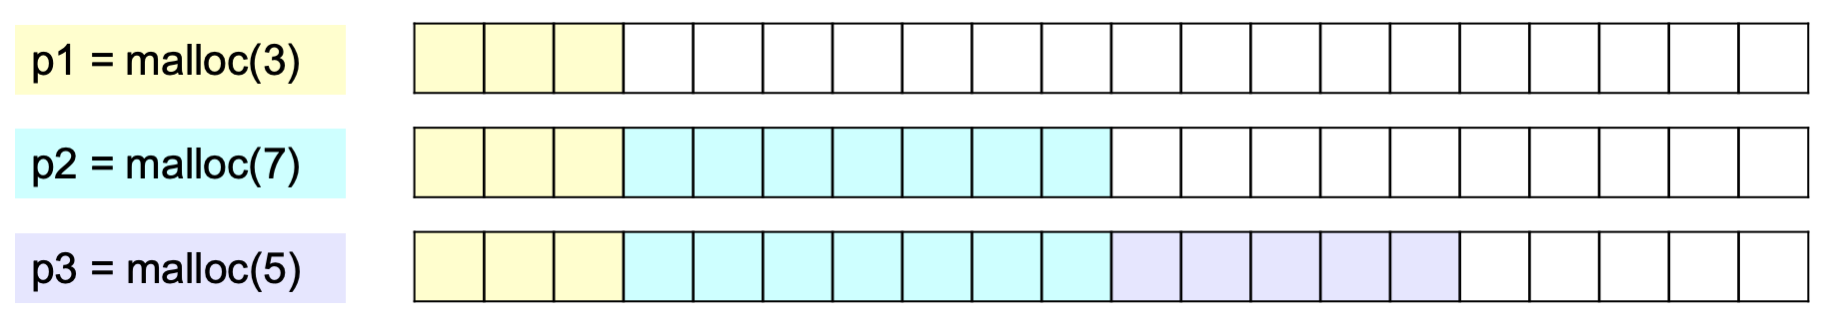
Concept (Implicit list)
Uses the structure made to choose an appropriate location to allocate new memory.

Slide 9
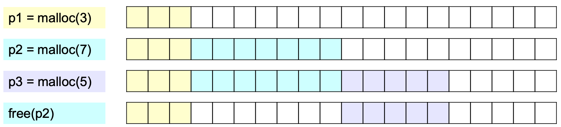
Concept (Implicit list)
Updates the structure when the user frees a block of memory.
Notes:
Go through the processes of 3 cases of allocating/freeing (related to coalesce) - do it on board

Slide 10
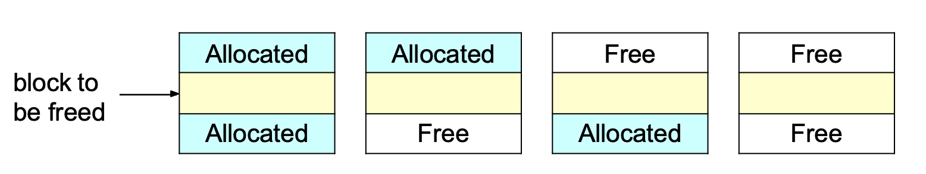
Concept (Implicit list)
Updates the structure when the user frees a block of memory.
Notes:
Go through the processes of 3 cases of allocating/freeing (related to coalesce) - do it on board

Slide 11
Goals
Run as fast as possible
Waste as little memory as possible
Seemingly conflicting goals, but with the library malloc call cleverness you can do very well in both areas!
The simplest implementation is the implicit list. mm.c uses this method.
Unfortunately…

Slide 12
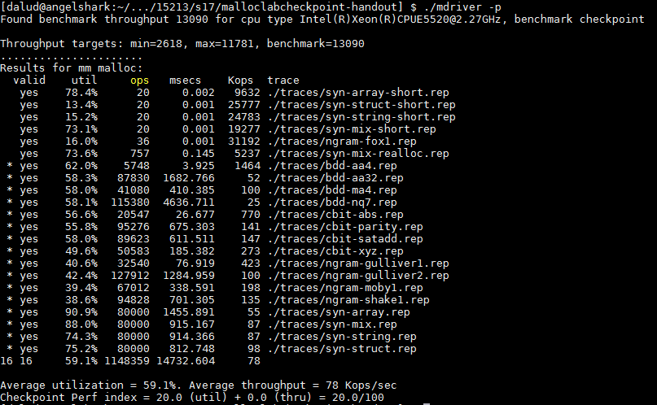
This is pretty slow… most explicit list implementations get above 2000 Kops/sec

Slide 13
Allocation methods in a nutshell
Implicit list: a list is implicitly formed by jumping between blocks, using knowledge about their sizes.
Explicit list: Free blocks explicitly point to other blocks, like in a linked list.
Understanding explicit lists requires understanding implicit lists
Segregated list: Multiple linked lists, each containing blocks in a certain range of sizes.
Understanding segregated lists requires understanding explicit lists
Allocated | Free | Allocated | Free | Allocated
 | Free |  | Free
 | Free |  | Free
Notes:
Monday TA Notes: Explicit lists and segregated lists have not been covered in detail at this point (will cover on Tuesday)

Slide 14
Choices
What kind of implementation to use?
Implicit list, explicit list, segregated lists, binary tree methods, etc.
You can use specialized strategies depending on the size of allocations
Adaptive algorithms are fine, though not necessary to get 100%.
Don’t hard-code for individual trace files - you’ll get no credit/code deductions!
What fit algorithm to use?
Best fit: choose the smallest block that is big enough to fit the requested allocation size
First fit / next fit: search linearly starting from some location, and pick the first block that fits.
Which is faster? Which uses less memory?
“Good enough” fit: a blend between the two
This lab has many more ways to get an A+ than, say, Cache Lab Part 2

Slide 15
Finding a Best Block
Suppose you have implemented the explicit list approach
You were using best fit with explicit lists
You experiment with using segregated lists instead. Still using best fits.
Will your memory utilization score improve? Note: you don’t have to implement seglists and run mdriver to answer this. That’s, uh, hard to do within one recitation session.
What other advantages does segregated lists provide?
Losing memory because of the way you choose your free blocks is called external fragmentation.
Notes:
Memory util is the same, but throughput may be faster.
If you decide to switch to a “good enough” fit policy, you may be able to get an increase on both fronts.

Slide 16
Metadata
All blocks need to store some data about themselves in order for malloc to keep track of them (e.g. headers)
This takes memory too…
Losing memory for this reason is called internal fragmentation.
What data might a block need?
Does it depend on the malloc implementation you use?
Is it different between free and allocated blocks?
Can we use the extra space in free blocks?
Or do we have to leave the space alone?
How can we overlap two different types of data at the same location?
Notes:
Yes, yes, yes (can use the space)
Unions! (See textbook)

Slide 17
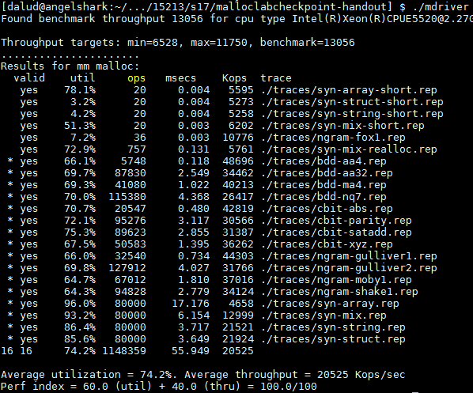
In a perfect world…
Setting up the blocks, metadata, lists… etc (500 LoC)
+ Finding and allocating the right blocks (500 LoC)
+ Updating your heap structure when you free (500 LoC) =

Slide 18

In reality…
Setting up the blocks, metadata, lists… etc (500 LoC)
+ Finding and allocating the right blocks (500 LoC)
+ Updating your heap structure when you free (500 LoC)
+ One bug, somewhere lost in those 1500 LoC =

Slide 19


Slide 20
Common errors you might see
Garbled bytes
Problem: overwriting data in an allocated block
Solution: remembering data lab and the good ol’ days finding where you’re overwriting by stepping through with gdb
Overlapping payloads
Problem: having unique blocks whose payloads overlap in memory
Solution: literally print debugging everywhere finding where you’re overlapping by stepping through with gdb
Segmentation fault
Problem: accessing invalid memory
Solution: crying a little finding where you’re accessing invalid memory by stepping through with gdb

Slide 21


Try running $ make
If you look closely, our code compiles your malloc implementation with the -O3 flag.
This is an optimization flag. -O3 makes your code run as efficiently as the compiler can manage, but also makes it horrible for debugging (almost everything is “optimized out”).
For malloclab, we’ve provide you a driver, mdriver-dbg, that not only enables debugging macros, but compiles your code with -O0. This allows more useful information to be displayed in GDB

Slide 22
The *Real* Activity: GDB Practice
Using GDB well in malloclab can save you HOURS^{1, 2} of debugging time
Average 20 hours using GDB for “B” on malloclab
Average 23 hours not using GDB for “B” on malloclab
Form pairs
wget https://www.cs.cmu.edu/~213/activities/f19-rec-malloc.tar
tar xvf f19-rec-malloc.tar
cd f19-rec-malloc
make
Two buggy mdrivers
* Average time is based on Summer 2016 survey results

Slide 23
Debugging Guidelines
If you have this problem...
You might want to...
Ran into segfault
Trace results don’t match yours
Don’t know what trace output should be
Locate a segfault
run
<>
backtrace
list
Reproduce results of a trace
Run with gdb
gdb args

Slide 24
Debugging mdriver
$ gdb --args ./mdriver -c traces/syn-mix-short.rep
(gdb) run
(gdb) backtrace
(gdb) list
Optional: Type Ctrl-X Ctrl-A to see the source code. Don’t linger there for long, since this visual mode is buggy. Type that key combination again to go back to console mode.
(Or use cgdb - see Piazza post)
1) What function is listed on the top of backtrace?
2) What line of code crashed?
3) How did that line cause the crash?

Slide 25
Debugging mdriver
(gdb) x /gx block
Shows the memory contents within the block
In particular, look for the header.
(gdb) print *block
Shows struct contents
Remember the output from (gdb) bt?
(gdb) frame 1
Jumps to the function one level down the call stack (aka the function that called write_footer)
Ctrl-X, Ctrl-A again if you want to see visuals
What was the caller function? What is its purpose?
Was it writing to block or block_next when it crashed?
Alternative: (gdb) print *(block_t *) <address>

Slide 26
Thought process while debugging
write_footer crashed because it got the wrong address for the footer…
The address was wrong because the header of the block was some garbage value
Since write_footer uses get_size(block) after all
But why in the world does the header contain garbage??
The crash happened in place, which basically splits a free block into two and uses the first one to store things.
Hm, block_next would be the new block created after the split? The one on the right?
The header would be in the middle of the original free block actually. Wait, but I wrote a new header before I wrote the footer!
Right? …Oh, I didn’t. Darn.

Slide 27
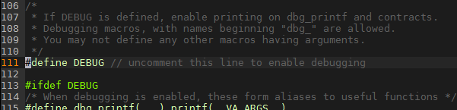
Heap consistency checker
mm-2.c activates debug mode, and so mm_checkheap runs at the beginning and end of many of its functions.
The next bug will be a total nightmare to find without this heap consistency checker*.
*Even though the checker in mm-2.c is short and buggy

Slide 28
Now you try debugging this - second example!
$ gdb --args ./mdriver-2 -c
traces/syn-array-short.rep
(gdb) run
Yikes… what error are we getting?
Notes:
This problem is tricky.
Coalesce returns the wrong block in case 3.

Slide 29

Now you try debugging this - second example!
$ gdb --args ./mdriver-2 -c traces/syn-array-short.rep
(gdb) run
Yikes… what error are we getting?
~ g a r b l e d b y t e s ~
* an accurate representation of what’s actually going on in your blocks
Notes:
This problem is tricky.
Coalesce returns the wrong block in case 3.

Slide 30
Now you try debugging this - second example!
(gdb) watch *0x8000026d0 /* Track from first garbled payload */
(gdb) run
(gdb) continue
(gdb) continue /* Keep going until coalesce_block */
(gdb) backtrace
(gdb) list
Ah, it seems like nothing’s amiss…
Notes:
This problem is tricky.
Coalesce returns the wrong block in case 3.

Slide 31
Running with mdriver-2-dbg...
Let’s run it with mdriver-2-dbg, which has a lower optimization - will give us more insight, like the stack trace below
(in the same gdb session)
(gdb) file mdriver-2-dbg
(gdb) run
(gdb) continue
…
(gdb) list
Notes:
This problem is tricky.
Coalesce returns the wrong block in case 3.

Slide 32
Running with mdriver-2-dbg...
Now try printing out the values of prev_alloc / next_alloc...
(gdb) print prev_alloc
(gdb) $1 = <optimized out>
%rip, they’re optimized out! We have to change the optimization level to get what we truly want.
Notes:
This problem is tricky.
Coalesce returns the wrong block in case 3.

Slide 33
Running with mdriver-2-dbg...
Go into your Makefile (vim Makefile) => change “COPT_DBG = -O0” so that all local variables are preserved
$ make clean
$ make
$ gdb --args ./mdriver-2-dbg -d 2 -c
traces/syn-mix-short.rep
(gdb) b mm-2.c:450 /* Cut to the chase… */
(gdb) run
(gdb) continue
…
(gdb) print next_alloc
(gdb) $1 = true /* SUCCESS! */
Notes:
This problem is tricky.
Coalesce returns the wrong block in case 3.

Slide 34
Strategy - Suggested Plan for Completing Malloc
0. Start writing your checkheap!
1. Get an explicit list implementation to work with proper coalescing and splitting
3. Get to a segregated list implementation to improve utilization
4. Work on optimizations (each has its own challenges!)
- Remove footers
- Decrease minimum block size
- Reduce header sizes
Notes:
Add animations - “Make sure your checkheap is working”
“Git commit”
“Valgrind”

Slide 35
Strategy - Suggested Plan for Completing Malloc
0. Start writing your checkheap!
1. Get an explicit list implementation to work with proper coalescing and splitting
3. Get to a segregated list implementation to improve utilization
4. Work on optimizations (each has its own challenges!)
- Remove footers
- Decrease minimum block size
- Reduce header sizes
Keep writing your checkheap!
Keep writing your checkheap!
Keep writing your checkheap!
Keep writing your checkheap!
Notes:
Add animations - “Make sure your checkheap is working”
“Git commit”
“Valgrind”

Slide 36

MallocLab Checkpoint
Due next Tuesday!
Checkpoint should take a bit less than half of the time you spend overall on the lab.
Read the write-up. Slowly. Carefully.
Use GDB - watch, backtrace
Ask us for debugging help
Only after you implement mm_checkheap though! You gotta learn how to understand your own code - help us help you!
please write checkheap or we will scream

Slide 37
Appendix: Advanced GDB Usage
backtrace: Shows the call stack
up/down: Lets you go up/down one level in the call stack
frame: Lets you go to one of the levels in the call stack
list: Shows source code
print <expression>:
Runs any valid C command, even something with side effects like mm_malloc(10) or mm_checkheap(1337)
watch <expression>:
Breaks when the value of the expression changes
break <function / line> if <expression>:
Only stops execution when the expression holds true
Ctrl-X Ctrl-A or cgdb for visualization

